Slide 1
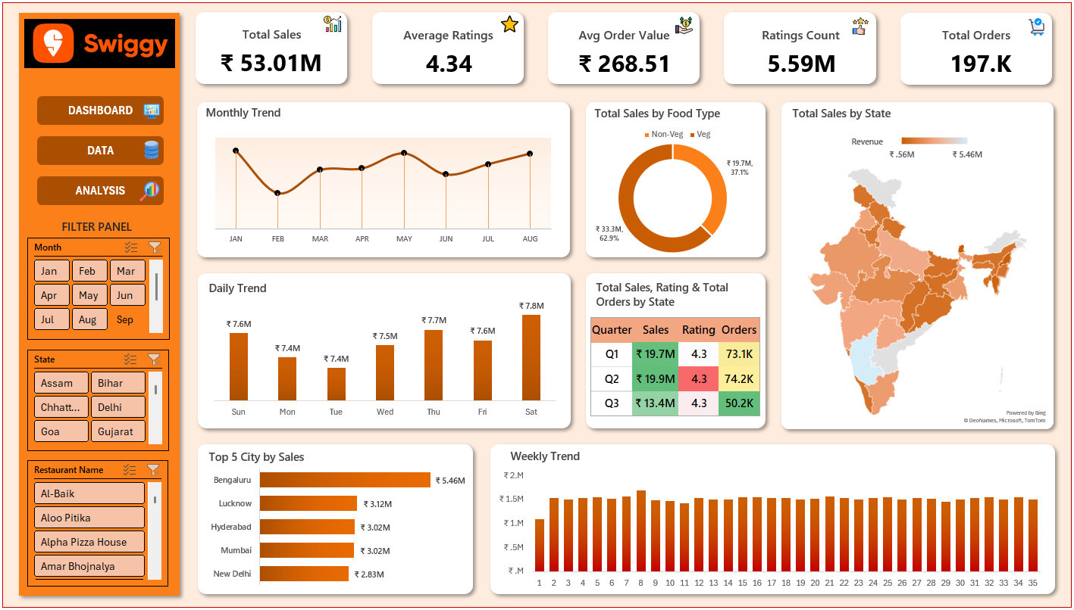


PROBLEM STATEMENT
KPI’s
Total Sales (₹) – Overall revenue generated from food orders.
Average Rating – Customer satisfaction level across all restaurants.
Average Order Value (₹) – Revenue per order.
Ratings Count – Total number of customer reviews.
Total Orders – Number of food orders received.

Slide 2
PROBLEM STATEMENT
CHART’S
Monthly Sales Trend – Shows how total sales fluctuate month by month.
Daily Sales Trend – Highlights order and revenue variations across days of the week.
Total Sales by Food Type (Veg vs Non-Veg) – Compares revenue contribution by cuisine type.
Veg vs Non-Veg : Number of Orders
Total Sales by State (Map Visualization) – Displays state-wise revenue distribution.
Top 5 Cities by Sales – Identifies leading cities contributing the most revenue.
Top 10 Restaurants by Revenue – Identifies dishes contributing the highest revenue.
Top 10 Most Ordered Dishes – Identifies most ordered dishes highlight customer food preferences.
Top 10 Dishes by Revenue – Identifies dishes contributing the highest revenue.
Quarterly Performance Summary – Combines Sales, Ratings, and Orders by Quarter.
Weekly Trend Analysis – Monitors weekly fluctuations in sales to identify consistency or peak periods.

